Slide 1
Data Structure and Algorithm CSE-225

Slide 2
Graph
Terminology
Sequential Representation of Graphs: Adjacency Matrix, Path Matrix
Warshall’s Algorithm (Path Matrix)
Shortest Path
Graph Traversal
Breath First Search (BFS)
Depth First Search (DFS)
Spanning Tree
Minimum Spanning Tree
Kruskal Algorithm
Prime’s Algorithm

Slide 3
Graph
A graph is a collection of nodes (or vertices) and edges (or arcs)
Each node contains an element
Each edge connects two nodes together (or possibly the same node to itself) and may contain an edge attribute
A directed graph is one in which the edges have a direction
An undirected graph is one in which the
edges do not have a direction

Slide 4
What is a Graph?
A graph G = (V,E) is composed of:
V: set of vertices
E: set of edges connecting the vertices in V
An edge e = (u,v) is a pair of vertices
Example:
a
b
V= {a,b,c,d,e}
E= {(a,b),(a,c),(a,d),
(b,e),(c,d),(c,e), (d,e)}
c
d
e

Slide 5
Some problems that can be
represented by a graph
computer networks
airline flights
road map
course prerequisite structure
tasks for completing a job
flow of control through a program and many more

Slide 6
A Directed Graph or digraph
A
B
E
C
D
V = [A, B, C, D, E]
E = [<A,B>, <B,C>, <C,B>, <A,C>, <A,E>, <C,D>]

Slide 7
Graph terminology
The size of a graph is the number of nodes in it
The empty graph has size zero (no nodes)
If two nodes are connected by an edge, they are neighbors (and the nodes are adjacent to each other)
The degree of a node is the number of edges it has
For directed graphs,
If a directed edge goes from node S to node D, we call S the source and D the destination of the edge
The edge is an out-edge of S and an in-edge of D
S is a predecessor of D, and D is a successor of S
The in-degree of a node is the number of in-edges it has
The out-degree of a node is the number of out-edges it has
6

Slide 8
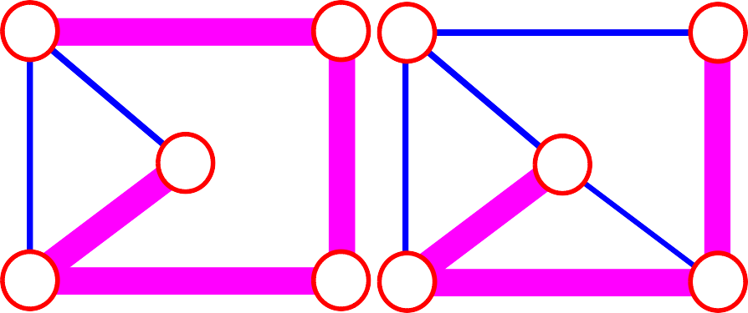
Terminology:
path: sequence of vertices v₁,v₂,. . .v_{k} such that consecutive vertices v_{i} and v_{i+1} are adjacent.
3
2
3
3
3
a
b
a
b
c
c
d
e
d
e
a b e d c
b e d c
7

Slide 9



More Terminology
simple path:
no repeated vertices
a b
b e c
c
d
e
cycle:
simple path, except that the last vertex is the same
as the first vertex
a b
a
a c d a
c
d
e

Slide 10
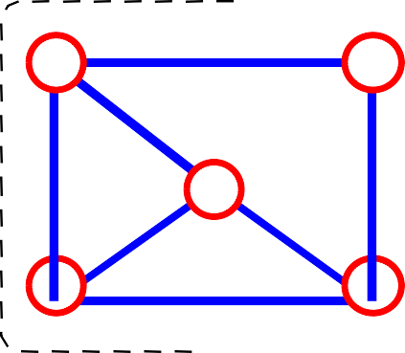
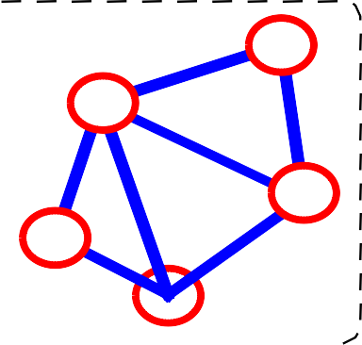
Even More Terminology
•connected graph: any two vertices are connected by some path
connected not connected
subgraph: subset of vertices and edges forming a graph
connected component: maximal connected subgraph. E.g., the graph below has 3 connected components.

Slide 11
Subgraphs Examples
0
0 0 1
2
0
1
2
1
2
3
1
2
3
G1
0
(i)
(ii) (iii) (iv)
(a) Some of the subgraph of G₁
3
0
0
0
0
1
1
1
1
2
2
(iii)
2
(i)
(ii)
(iv)
G3
(b) Some of the subgraph of G₃

Slide 12









More…
tree - connected graph without cycles
forest - collection of trees
tree
tree
forest
tree
tree

Slide 13
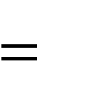
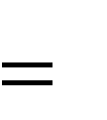
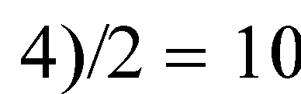

Connectivity
Let n = #vertices, and m = #edges
A complete graph: one in which all pairs of vertices
are adjacent
How many total edges in a complete graph?
– Each of the n vertices is incident to n-1 edges, however, we would have counted each edge twice!
Therefore, intuitively, m = n(n -1)/2.
Therefore, if a graph is not complete, m < n(n -1)/2
n 5
m (5

Slide 14
Directed vs. Undirected Graph
An undirected graph is one in which the pair of vertices in a edge is unordered,
(v0, v1) = (v1,v0)
A directed graph is one in which each
edge is a directed pair of vertices, <v0,
V1 > != <v1,v0>
tail
head

Slide 15
Graph terminology
An undirected graph is connected if there is a path from every node to every other node
A directed graph is strongly connected if there is a path from
every node to every other node
Node X is reachable from node Y if there is a path from Y to X
16

Slide 16
Graph data structures
storing the vertices
each vertex has a unique identifier and, maybe, other information
for efficiency, associate each vertex with a number that can be used as an index
storing the edges
adjacency matrix – represent all possible edges
adjacency lists – represent only the existing edges

Slide 17
storing the vertices
when a vertex is added to the graph,
assign it a number
vertices are numbered between 0 and n-1
graph operations start by looking up the number associated with a vertex
many data structures to use
any of the associative data structures
for small graphs a vector can be used
search will be O(n)

Slide 18
the vertex vector
0
A
1
B
4
E
A
B
C D E
0
1
2
3
4
C
2
D
3

Slide 19
adjacency matrix
0
1
2
3
4
A B
C
D E
0
A
1
B
4
E
0 1 2 3 4
0
1
2
3
4
0 | 1 | 1 | 0 | 1
0 | 0 | 1 | 0 | 0
0 | 1 | 0 | 1 | 0
0 | 0 | 0 | 0 | 0
0 | 0 | 0 | 0 | 0
C
2
D
3

Slide 20


Examples for Adjacency Matrix
0
0
1
2
1
3
G2
G1
2
0 1 0
1 0 1
0 0 0
0 1 1 1
1 0 1 1
1 1 0 1
1 1 1 0
Asymmetric
symmetric

Slide 21
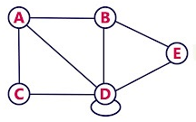
Examples for Adjacency Matrix
 | A | B | C | D | E
A
B
C
D
E

Slide 22
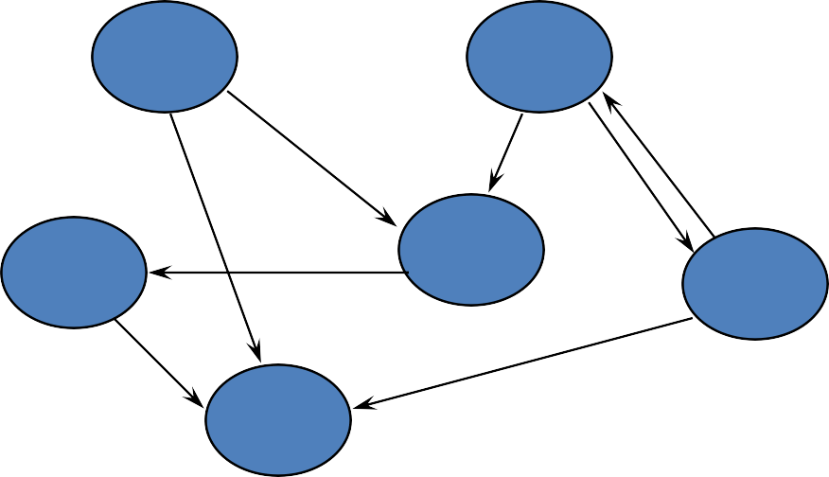
maximum # edges?
a V² matrix is needed for
a graph with V vertices

Slide 23
adjacency lists
0
A
0
1
2
3
4
A
B
C D E
1
B
4
E
C
2
D
3
0
1
2
3
4
1
2
4
2
1
3

Slide 24
0
1
2
3
0
1
2
3
1
2
3
0
2
3
0
1
3
0
1
2
G1
0
0
1
2
1
0
2
1
G3
2

Slide 25
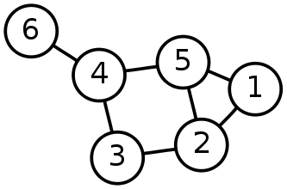
Single-Source Shortest Path Problem
Single-Source Shortest Path Problem - The problem of finding shortest paths from a source vertex v to all other vertices in the graph.

Slide 26
Dijkstra's algorithm
Dijkstra's algorithm - is a solution to the single-source shortest path problem in graph theory.
Works on both directed and undirected graphs. However, all edges must have nonnegative weights.
Approach: Greedy
Input: Weighted graph G={E,V} and source vertex v∈V, such that all edge weights are nonnegative
Output: Lengths of shortest paths (or the shortest paths themselves) from a given source vertex v∈V to all other vertices

Slide 27
Dijkstra's algorithm - Pseudocode
dist[s] ←0 (distance to source vertex is zero) for all v ∈ V–{s} do dist[v] ←∞ (set all other distances to infinity) S←∅ (S, the set of visited vertices is initially empty) Q←V (Q, the queue initially contains all vertices) while Q ≠∅ (while the queue is not empty) do u ← mindistance(Q,dist) (select the element of Q with the min. distance) S←S∪{u} (add u to list of visited vertices) for all v ∈ neighbors[u] do if dist[v] > dist[u] + w(u, v) (if new shortest path found) then d[v] ←d[u] + w(u, v) (set new value of shortest path)
(if desired, add traceback code)
return dist

Slide 28
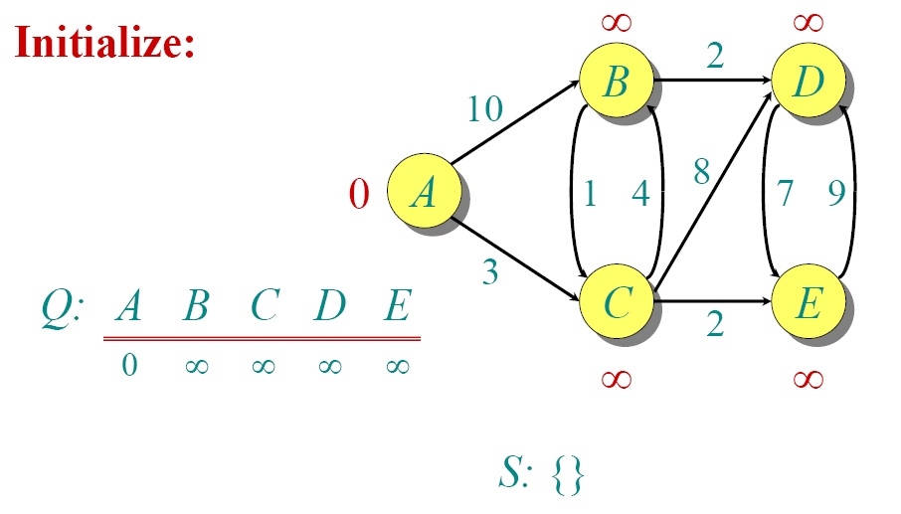
Dijkstra Animated Example

Slide 29
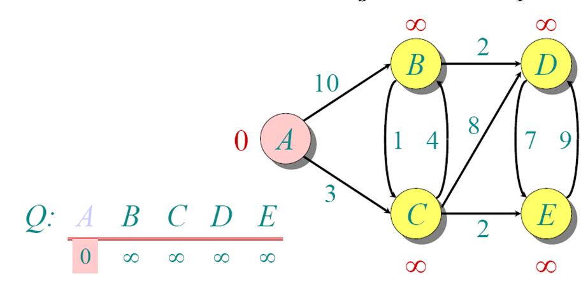
Dijkstra Animated Example

Slide 30
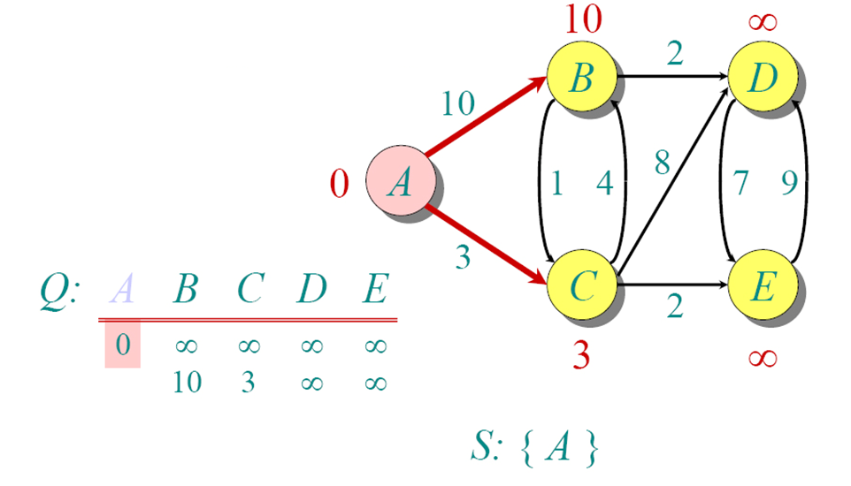
Dijkstra Animated Example

Slide 31
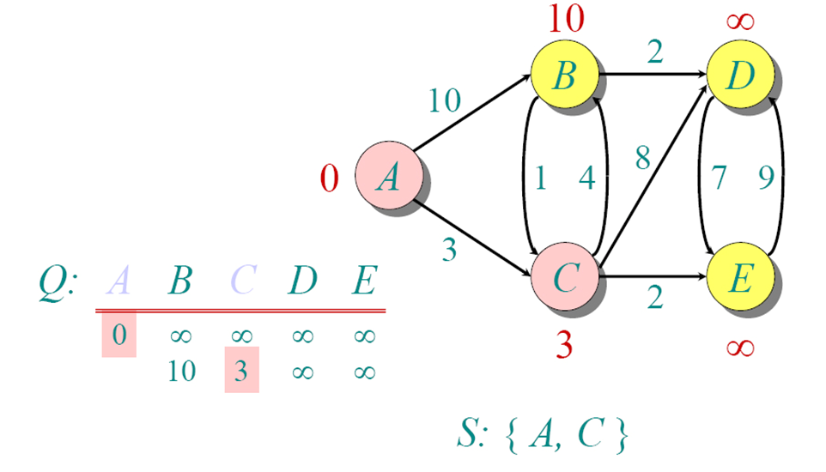
Dijkstra Animated Example

Slide 32
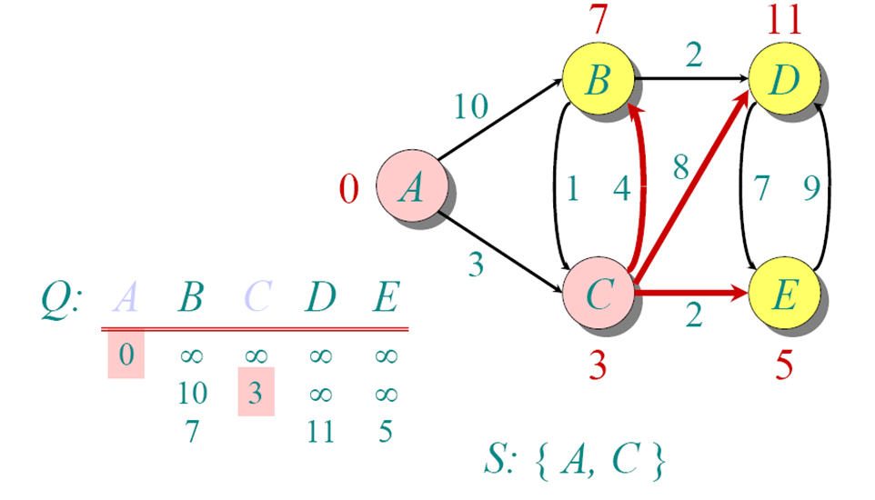
Dijkstra Animated Example

Slide 33
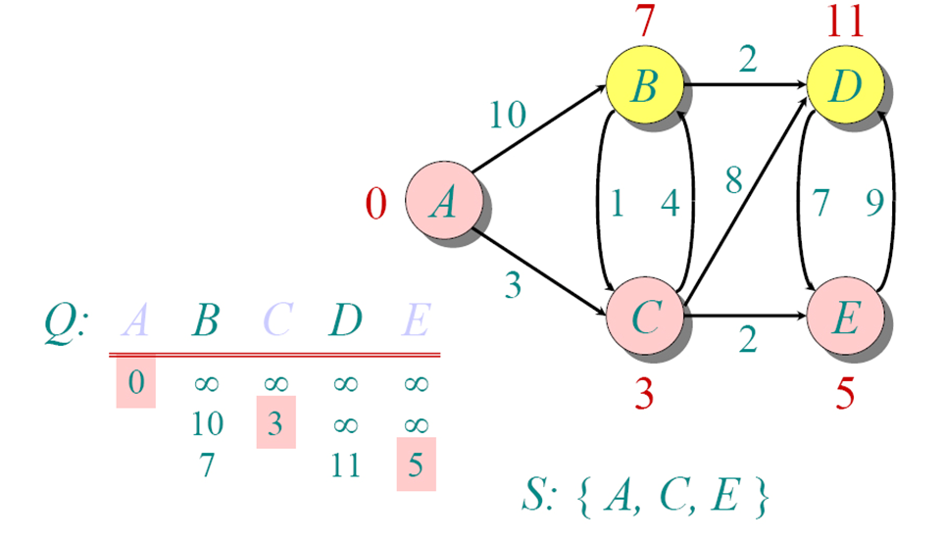
Dijkstra Animated Example

Slide 34
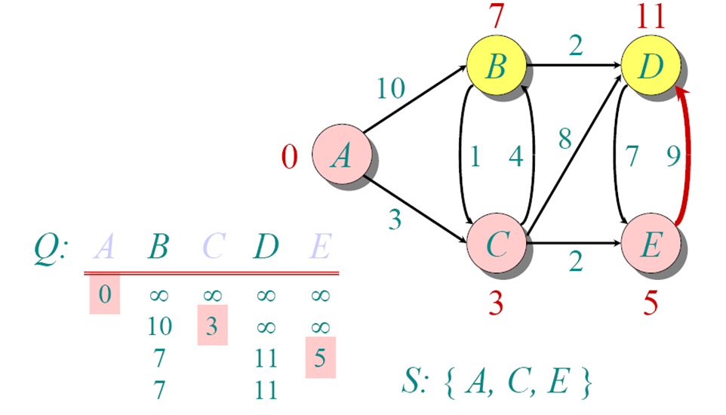
Dijkstra Animated Example

Slide 35
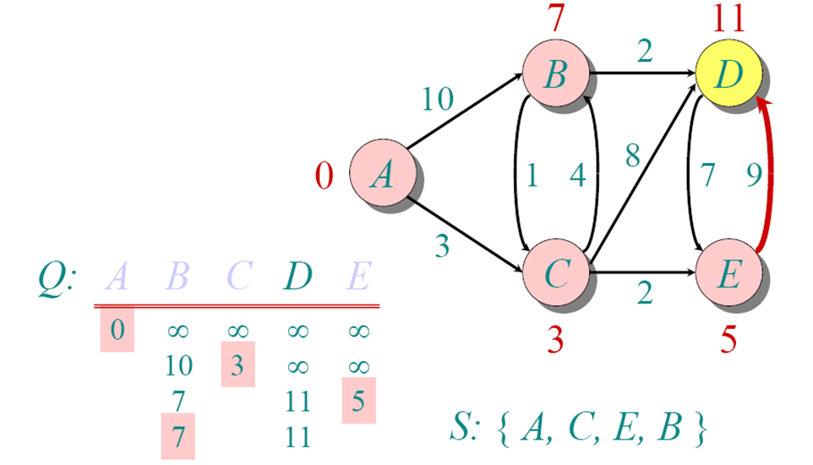
Dijkstra Animated Example

Slide 36
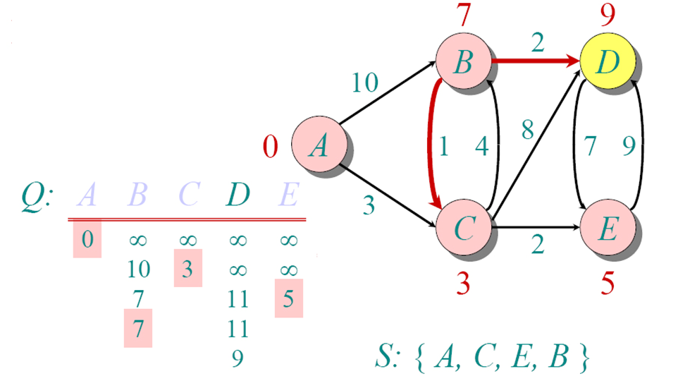
Dijkstra Animated Example

Slide 37
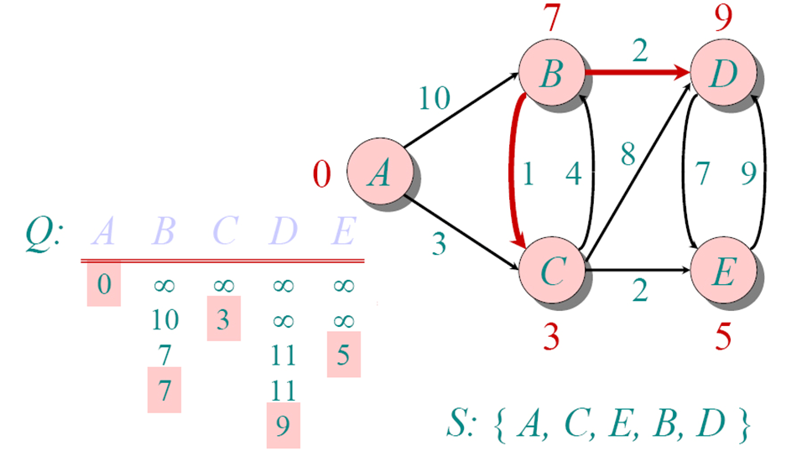
Dijkstra Animated Example

Slide 38
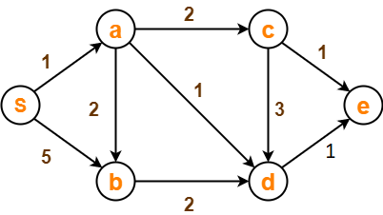
Dijkstra Example
Step through Dijkstra’s Algorithm to calculate the single source shortest path from s to every other vertex. You only need to show your final table, but you should show your steps in the table below for partial credit. Show your steps by crossing through values that are replaced by a new value

Slide 39
Dijkstra Example
S={a}
Q | s | a | b | c | d | e

Slide 40
Dijkstra Example
Step through Dijkstra’s Algorithm to calculate the single source shortest path from s to every other vertex. You only need to show your final table, but you should show your steps in the table below for partial credit. Show your steps by crossing through values that are replaced by a new value
S={s,a,d,b,c,e}
s | a | b | c | d | e
0 | ∞ | ∞ | ∞ | ∞ | ∞
 | 1 (s,a) | 5 | ∞ | ∞ | ∞
 |  | 3 | 3 | 2 (s,a,d) | ∞
 |  | 3 (s,a,b) |  |  | 3
 |  |  | 3 (s,a,c)
 |  |  |  |  | 3 (s,a,d,e)

Slide 41
Implementations and Running Times
The simplest implementation is to store vertices in an array or linked list. This will produce a running time of
O(|V|^2 + |E|)
For sparse graphs, or graphs with very few edges and many nodes, it can be implemented more efficiently storing the graph in an adjacency list using a binary heap or priority queue. This will produce a running time of
O((|E|+|V|) log |V|)

Slide 42
Dijkstra's Algorithm - Why It Works
As with all greedy algorithms, we need to make sure that it is a correct algorithm (e.g., it always returns the right solution if it is given correct input).
A formal proof would take longer than this presentation, but we can understand how the argument works intuitively.
If you can’t sleep unless you see a proof, see the second reference or ask us where you can find it.

Slide 43
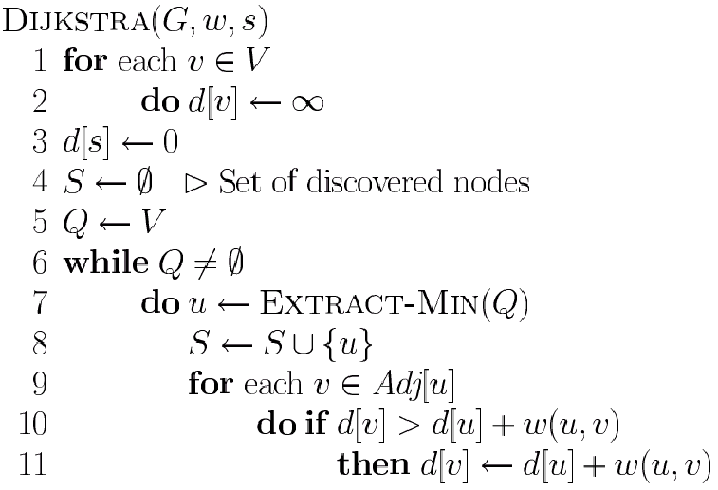
Dijkstra’s Algorithm
Graph G, weight function w, root s
relaxing edges

